Slide 1


SUMMER
TRAINING
LEARNING
applied to
PROJECT
Kanak Pathak (02520803114)
Varsha Varshney (30120803114)
B-Tech (IT) 3rd Year, 5th Semester
Bhagwan Parshuram Institute of Technology,
Rohini,Delhi

Slide 2

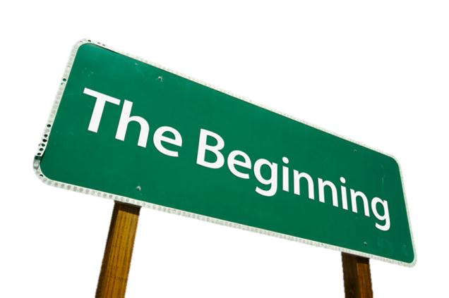
NTRODUCTION
Marine Travels is the project developed to plan a journey via waterways. It is developed using JAVA and MySQL.
It allows one to look up for the places and the ships and retrieve up to the minute information regarding the available routes and journey estimate.
One can also look for this project as a means for shipping their goods. It is very important to aware people that shipping the goods via waterways is all economical and eco-friendly as compared to other ways.

Slide 3

OBJECTIVE
To offer a variety of travel services that are sure to match all your priorities.
To globalism, organize, standardize and goal of journey towards perfectionism.
To make strong relationship with customers so that they can enjoy the holiday of their dreams.
Our objective is just an initiative of an idea, it will be made to more further and developed work of art.

Slide 4
PLAN OF ACTION (Methodology)
Making of front end.
Creating various tables in database as needed.
Connection of front end to back end (connection of Jforms to database).
Modifying various details by admin.
Declaring of result.

Slide 5
Making Of Front End
Developing a blueprint of how the frames will look and will be linked to one another.
Implementing the blueprint in Java Netbeans by making the Jframes and to get a go with the click many of the swing components have been added.
Front end has been coded in a way to provide maximum user friendliness and ease.
Notes:
Support System Development and Implementation:
Raising Capacities and Awareness
Registration of EHS Consultants
EHS Electronic Database
Conferences
International Cooperation
Incentives

Slide 6
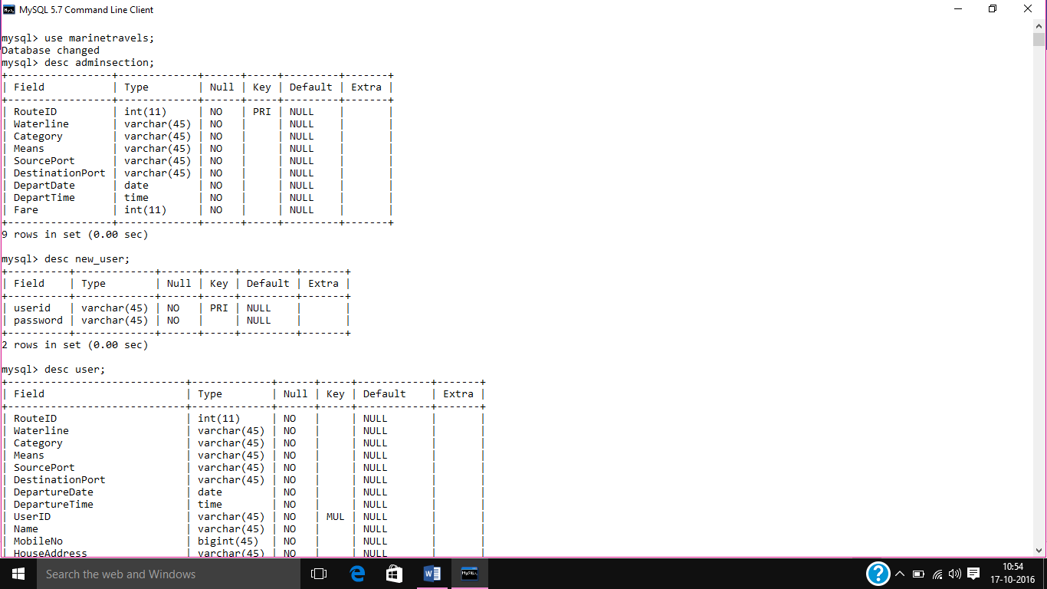
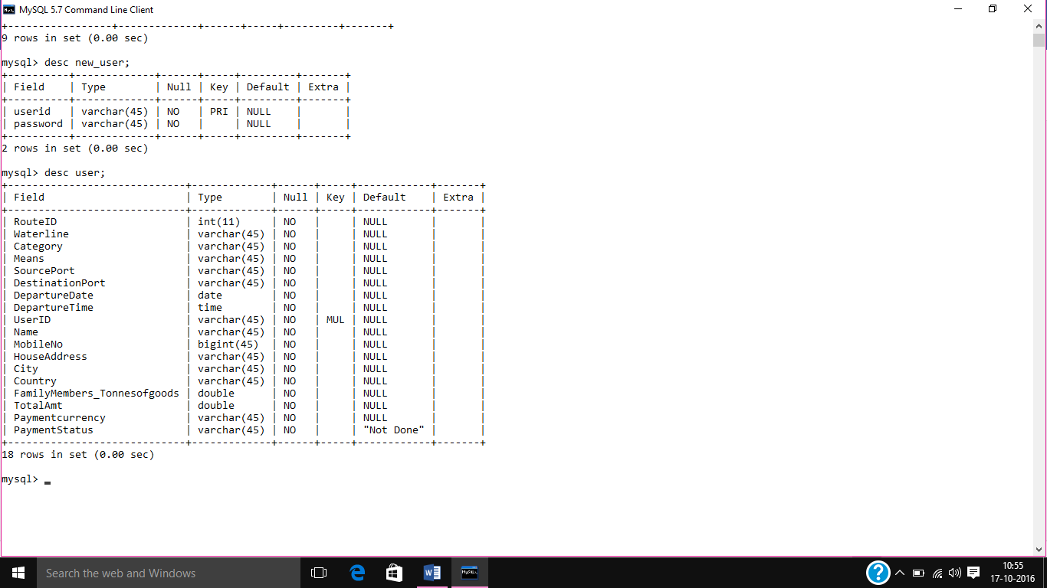
Creating Tables in Database (Back End)
The next step was to
create a database.
Using MySQL Server 5.7 we created the three main database tables :
Adminsection
New User
User

Slide 7
Connection Of Front End ->Back End
Connectivity : A connection string is used to connect the queries written in front end codes with database.
Using mysqlconnector net 6.9.9 which is a jar file that helps to connect the front end with the database we have made the connections.
Use of JDBC was one of the key for the connections. It is a Java API for executing SQL statements.

Slide 8
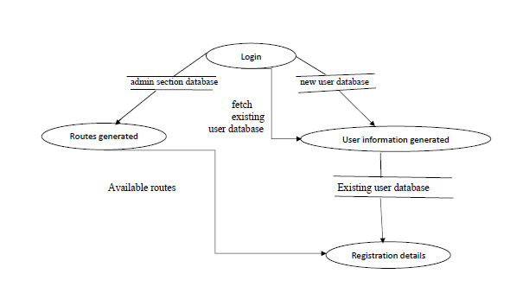
Data Flow Diagram

Slide 9
MODULES
Admin enters his/her user id and password for login to enter Admin Page.
Admin can maintain his/her data sources and generate the available routes.
ADMINISTRATOR MODULE
USER
Users can call or visit with trip details.
User can register and can enters his/her complete itinerary details with dates and time to further for tickets.
USER MODULE

Slide 10
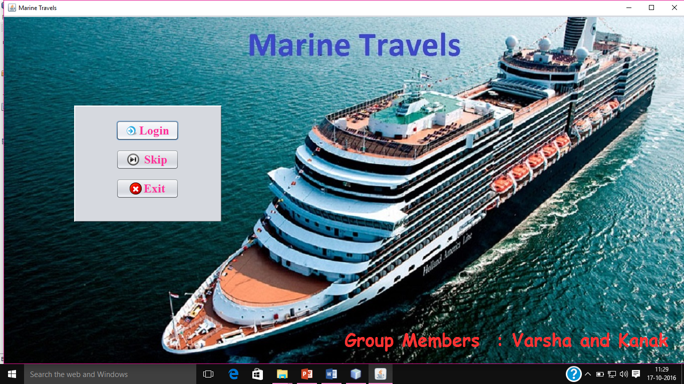
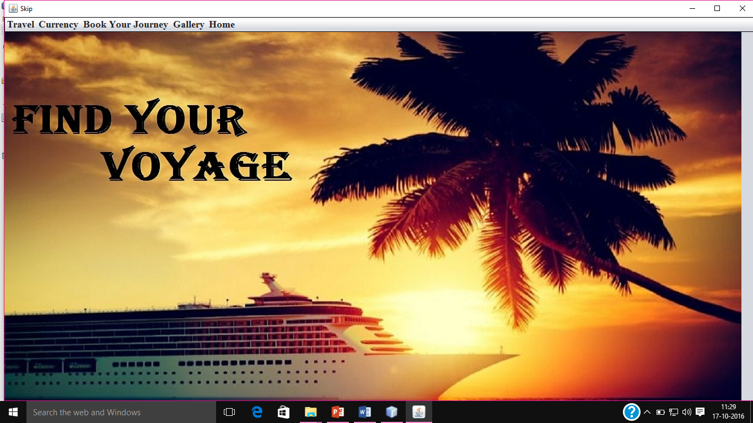
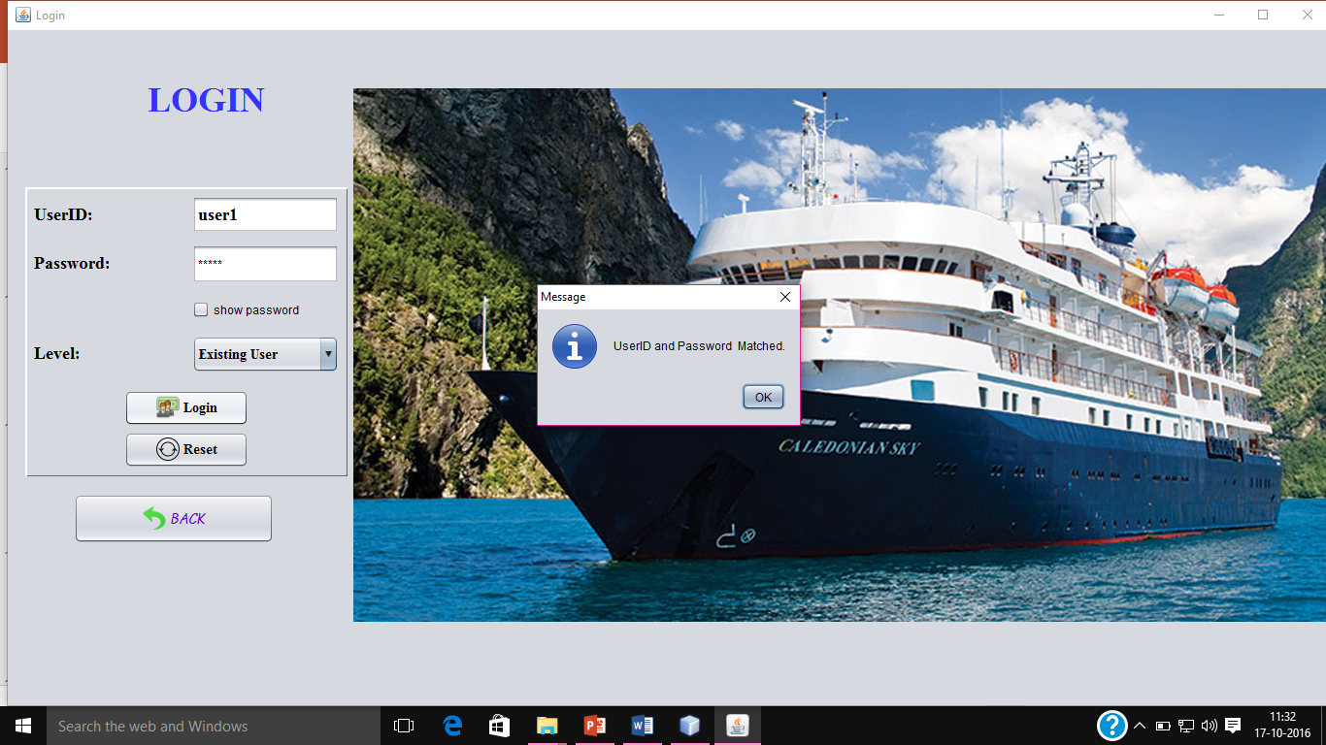
RESULT

Slide 11
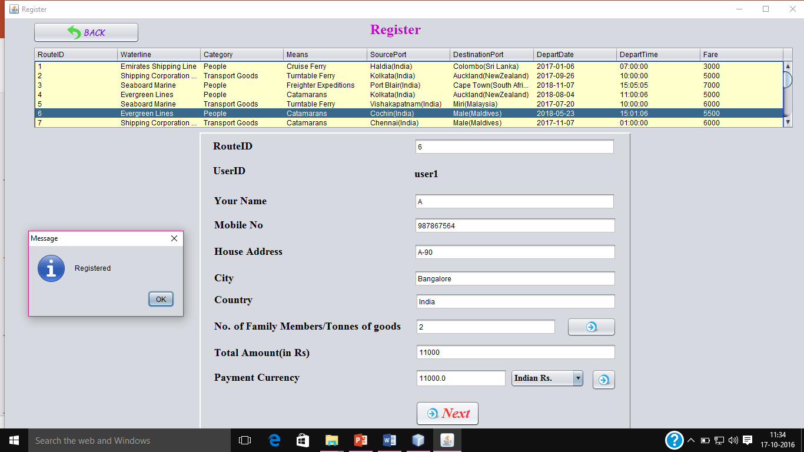
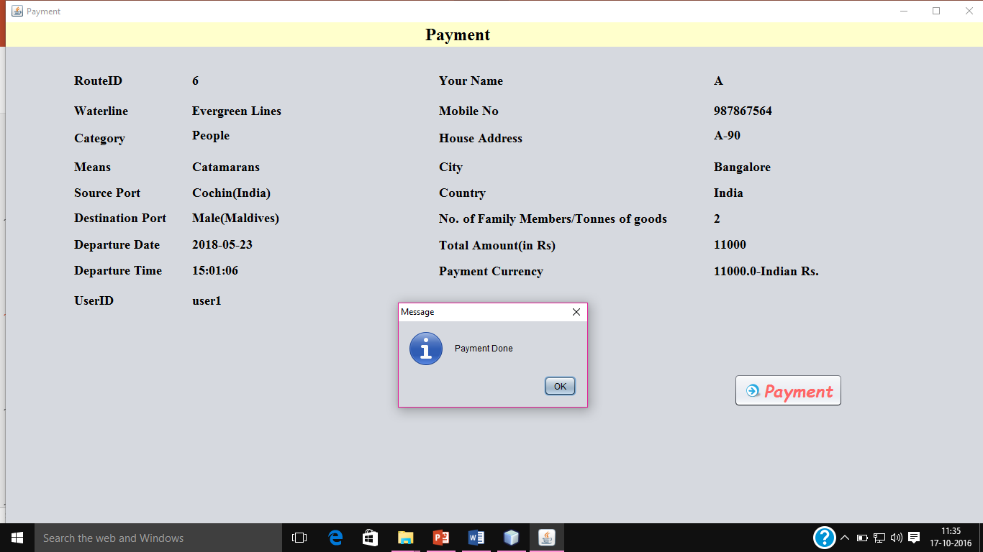
RESULT

Slide 12
CONCLUSION
MARINE TRAVEL project was for users to view and plan for the beautiful location for their holidays and connect with the admin for further details. Shipment of goods was also one of the focus of this project.
This project has a wider scope of being implemented in Web based Applications.
There are further more additions that need to be made.
Including complete payment processing system.
Enabling it to work with large database scale.

Slide 13
LEARNING OUTCOME
If you have little knowledge then don’t be afraid to explore more (seekhoge tabhi to seekhoge).
You need a deadline for your work.
You need to start to reach somewhere.
Notes:
There is black for negative, yellow for positive, green for creativity, blue for facts, red for emotions.

Slide 14
THANK YOU

